Slide 1


Statistical Modelling with Data
May 23 – June 02, 2023
Instructor: Qing (Leah) Li, Ph.D. Candidate at Cumming School of Medicine
qing.li2@uclagary.ca
Thank you Dr. Thuntida Ngamkham for contributing the contents
Thank you Dr. Qingrun Zhang and Dr. Quan Long for contributing some slides

Slide 2
Statistical Modelling with Data
Topic 1: Statistical Modelling
Lecture 1: First-order models with quantitative independent variables
Topic 2: Statistical Modelling with interactions (Assignment 1)
Lecture 2: Interaction effects, quantitative and qualitative variables
Lecture 3: Interaction effects and second-order models
Topic 3: Statistical Model selection (Assignment 2)
Lecture 4: Model selection: Stepwise regression, Forward selection and Backward Elimination
Lecture 5: Model selection: Evaluate the reliability of the model chosen
Topic 4: Statistical model diagnostics
Lecture 6: Multiple regression diagnostics: verify linearity, independence, and equal variance assumptions.
Lecture 7: Multiple regression diagnostics: verify normality assumptions, identify multicollinearity and outliers and data transformation.
Topic 5: Transfer learning
Lecture 8: Deep learning basics
Lecture 9: Transfer-learning (Bonus): standing on the shoulders of giants.

Slide 3
Statistical Modelling with Data
Topic 1: Statistical Modelling
Lecture 1: First-order models with quantitative independent variables
Topic 2: Statistical Modelling with interactions (Assignment 1)
Lecture 2: Interaction effects, quantitative and qualitative variables
Lecture 3: Interaction effects and second-order models
Topic 3: Statistical Model selection (Assignment 2)
Lecture 4: Model selection: Stepwise regression, Forward selection and Backward Elimination
Lecture 5: Model selection: Evaluate the reliability of the model chosen
Topic 4: Statistical model diagnostics
Lecture 6: Multiple regression diagnostics: verify linearity, independence, and equal variance assumptions.
Lecture 7: Multiple regression diagnostics: verify normality assumptions, identify multicollinearity and outliers and data transformation.
Topic 5: Transfer learning
Lecture 8: Deep learning basics
Lecture 9: Deep learning advances: Transfer-learning (Bonus).
Notes:
The first lecture does not frighten you. I hope you can still bare with my English with accents for the rest of courses.
Many I ask some of your feedbacks for yesterday’s courses? You know these courses won’t be graded and all we ask is to attend six lectures to get the certificate. However, there must be something more than certificate you want to get from this course. I hope that I can really help you understand some basics of statistical modelling. I am not sure what’s your exceptions from this course.

Slide 4
Statistical Modelling with Data
Learning Outcomes: At the end of the course, participants will be able to
Model the multiple linear relationships between a response variable (Y) and all explanatory variables (both categorical and numerical variables) with interaction terms. Interpret model parameter estimates, construct confidence intervals for regression coefficients, evaluate model fits, and visualize correlations between a response variable (Y) and all explanatory variables (X) by graphs (scatter plot, residual plot) to assess model validity.
Predict the response variable at a certain level of the explanatory variables once the fit model exists.
Implement R-software and analyze statistical results for biomedical and other data.
Evaluations
Assignments will be posted on Slack (our communication tool with students).
Students must attend 70% (6/9) of the sessions in order to receive the certificate and are encouraged to work on the assignments progressively throughout the course as the relevant material is covered.

Slide 5

Statistical Modelling with Data
Supportive materials
Lectures slides (2023)
R code scripts (2023)
PDF (dated 2022)
Two Assignments (dated 2022)
Slack channels
Recoding videos
Exercises
Course-documents

Slide 6
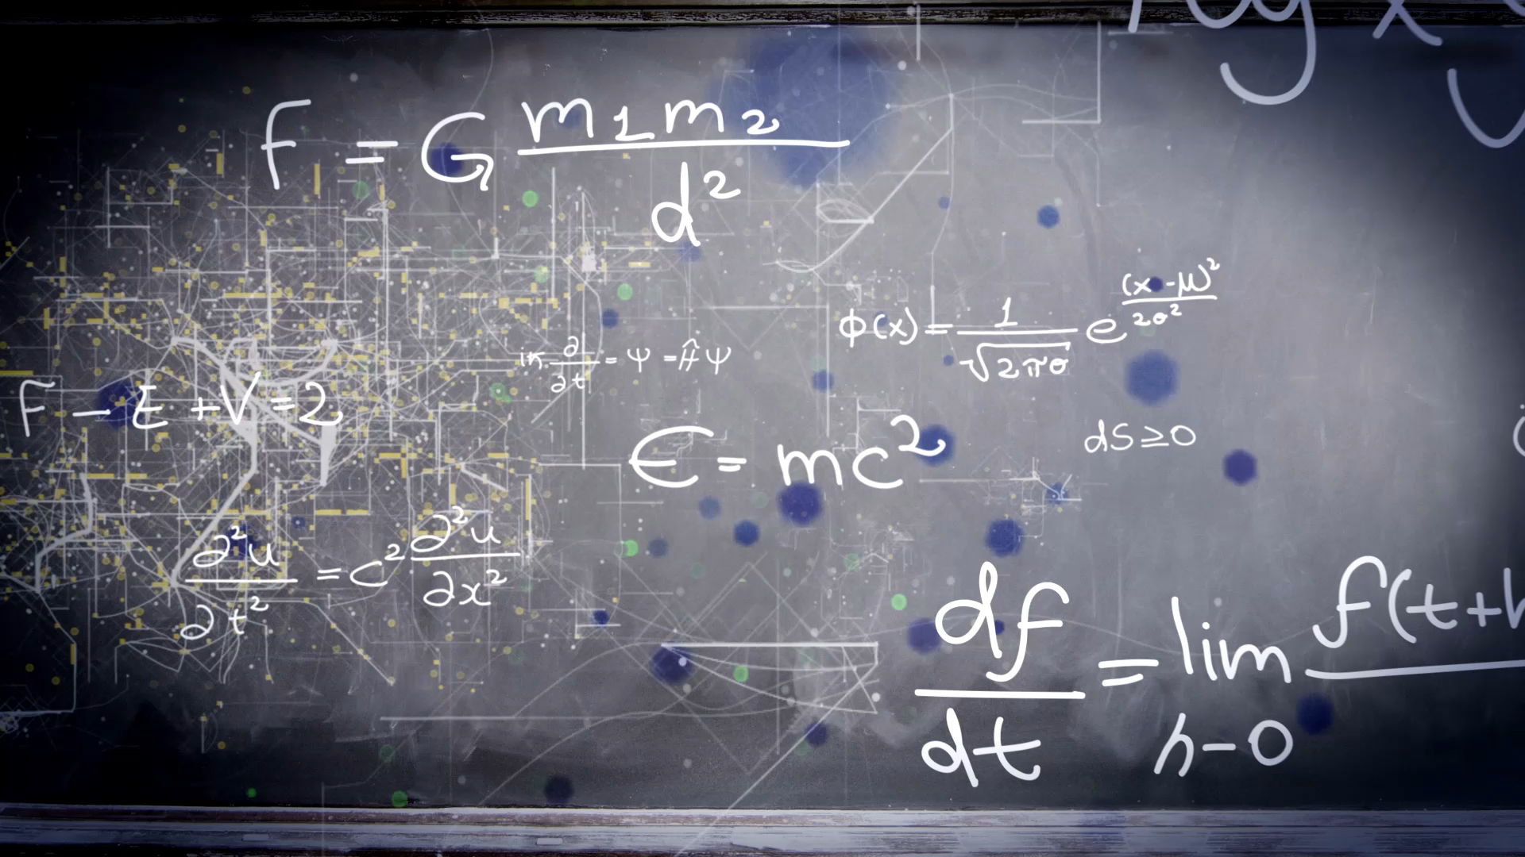
Lecture 6: Multiple regression diagnostics: verify linearity, independence, and equal variance

Slide 7
Plots
R: plot()
Pros:
Easy to write and learn by heart
Cons:
Does not incorporate advanced functions such as fitting curves to points
Multiple figures in one panel
par(mfrow=c(nrow, ncol))
ggplot2 package: ggplot()
Pros:
Multiple choices, high-level functions
Cons:
It takes a while to understand and learn the functions by heart
Multiple figures in one panel
grid.arrange(p1,p2, nrow = 3,top = “Title").

Slide 8
Workflow of regression analysis
State a hypothesis
Data exploration
Build a statistical model
Model Diagnostics:
Residual VS fitted plot, Normal QQ plot of residuals, added variables plots, influence plot (residual vs. leverage)
Fix the biggest problem and go back to 3
Compare alternative models with reduced model
Interpret the regression coefficients are the effect large and what they mean in your research context.

Slide 9
Workflow of regression analysis ( modified by Leah)
State a hypothesis
Data exploration
Build statistical models (different approaches)
Diagnose if the optimal model from different approaches violet assumptions or not. If not, these model are validated.
If not, fix the problem and conduct model diagnostic until identify a model satisfy all assumptions.
Interpret the regression coefficients are the effect large and what they mean in your research context.

Slide 10
What are model diagnostics?
Most statistical tests rely upon certain assumptions about the variables used in the analysis. When these assumptions are not met the results may not be trustworthy. The assumptions and conditions for the multiple regression model sound nearly the same as for simple linear regression, but with more variables in the model.
Even if you have a solid theoretical basis for your assumptions, they may still turn out to be incorrect.
Model diagnostics are visual and numeric guides to:
Help decide whether the assumptions taken hold up in all samples;
Provide an indication of why an assumption is violated.
Model diagnostics are not:
An indication that the assumption are correct
An indication that the model is right or wrong. It points out the model is suboptimal as model violet the assumption.
Assumptions must be based on theory. No test or visual diagnostic plot can tell you which assumption to choose, only whether they hold up reasonably well in your studies samples or not.

Slide 11
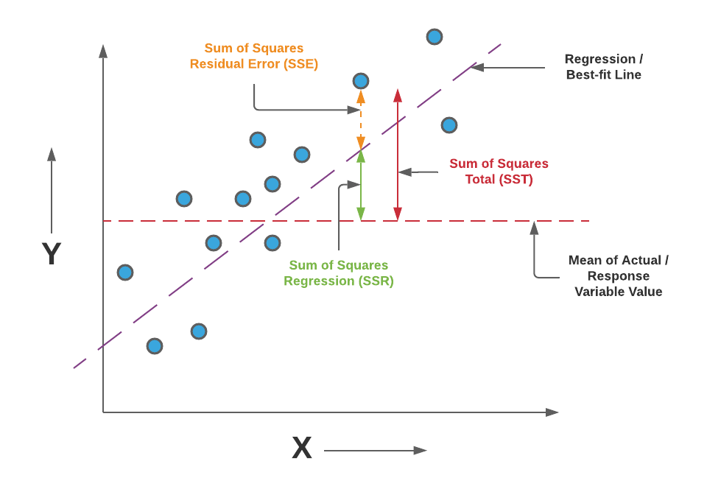
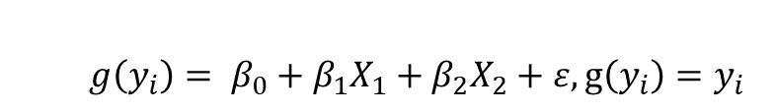
Assumptions
response, coefficients of correlation, predictors
$$g\left(y_{i}\right)= β_{0}+β_{1}X_{1}+β_{2}X_{2}+ε, g\left(y_{i}\right)=y_{i}$$
Linearity Assumption
Relationships between all predictors and the response are linear
Independence Assumption
Independence of observations
Equal Variance Assumption
Error term (Residuals) has equal variance given any values of independent variables
Normality Assumption
Error term (Residuals) is normally distributed
Outlier
Error terms (Residuals) has expected value of zero given the values of independent variables
Multicollinearity
No perfect collinearity and non-zero variance of independent variables

Slide 12
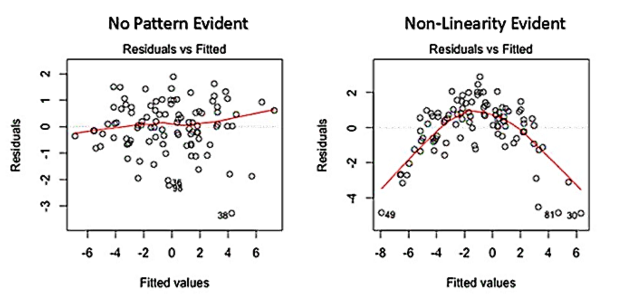
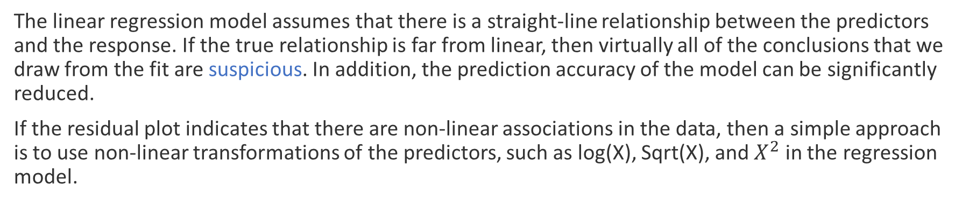
1. Linearity Assumption
The linear regression model assumes that there is a straight-line relationship between the predictors and the response. If the true relationship is far from linear, then virtually all of the conclusions that we draw from the fit are suspicious. In addition, the prediction accuracy of the model can be significantly reduced.
If the residual plot indicates that there are non-linear associations in the data, then a simple approach is to use non-linear transformations of the predictors, such as log(X), Sqrt(X), and $X^{2}$ in the regression model.

Slide 13
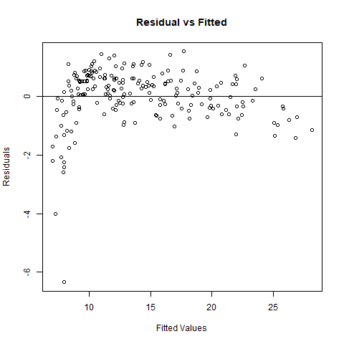
Advertising data
model<-lm(sale~tv+radio+tv:radio, data=Advertising)
There appears to be a little pattern in the residuals,
suggesting that the quadratic term or logarithmic might improve the fit to the data.

Slide 14
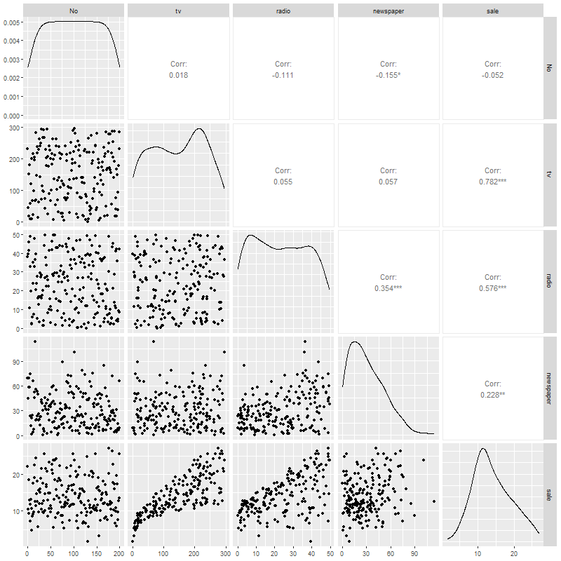
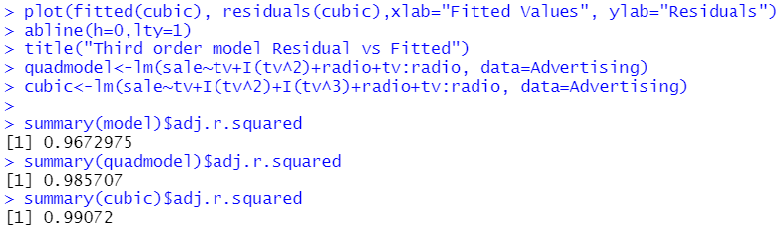
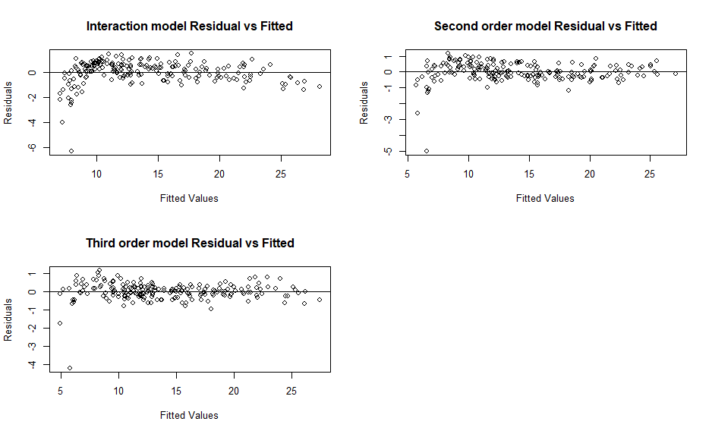
Advertising data: Pairwise correlation
Conclusion: residuals from third order model do not have an obvious pattern with fitted values.

Slide 15


In class Practice Problem 16
From the clerical staff work hours, use residual plots to conduct a residual analysis of the data.
Begin with the model: Y ~ X2 + X4 + X5
Check whether this model meets the linearity assumption
If it doesn’t (it doesn’t), use ggpairs() to identify potential terms that might be transformed in a higher order model.
Fit that higher order model and evaluate.
Lecture_6.R
15

Slide 16
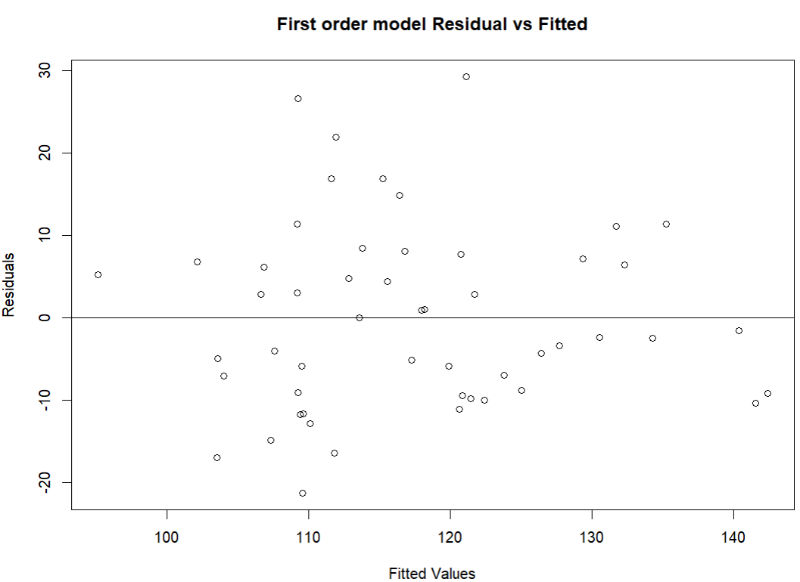
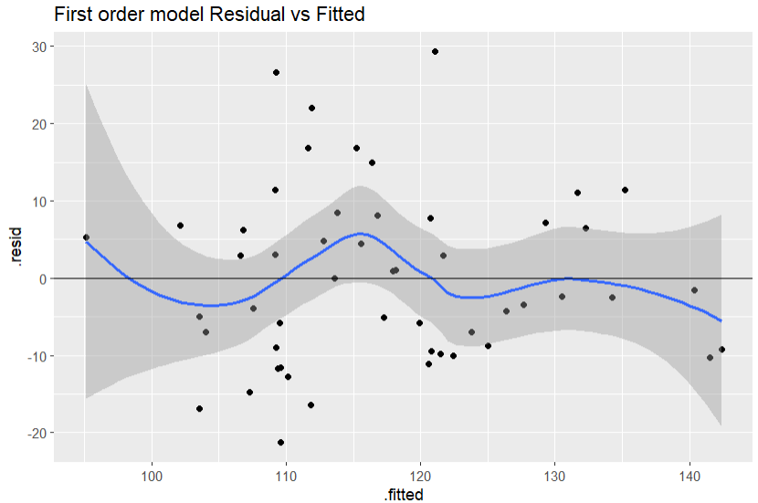
In class Practice Problem 16 Answers
Pattern is not quite obvious with plot, but observable. Maybe better with ggplot() as it can fit a line to data
Based on these two figures, we observed patterns between residuals of the model and response.
>>This model does not satisfy the linearity assumption.
Lecture_6.R
16

Slide 17
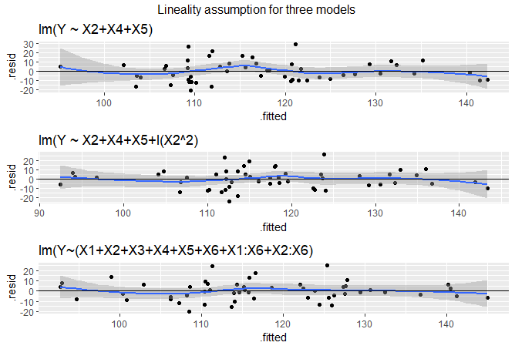
In class Practice Problem 16 Answers
Optimal models from the problem 15:
optimal_model_approach1=lm(Y ~ X2+X4+X5+I(X2^2), data=workhours)
optimal_model_approach2=lm(Y ~ X2+X4+X5+I(X2^2), data=workhours)
optimal_model_approach3 <-lm(Y~(X1+X2+X3+X4+X5+X6+X1:X6+X2:X6), data=workhours)
The bottom two models appear to meet linearity assumption.
Lecture_6.R
17

Slide 18
2. Independence Assumption
An important assumption of the linear regression model is that the error terms, ϵ1, ϵ2, ϵ3, ..., ϵn are uncorrelated (must be mutually independent). What does this mean? For instance, if the errors are uncorrelated, then the fact that ϵi is positive provides little or no information about the sign of ϵi+1.
The assumption of independent errors is violated when successive errors are correlated. This typically occurs when the data for both dependent and independent variables are observed sequentially over a period of time-called time-series data
We can check displays of the regression residuals for evidence of patterns, trends or clumping, any of which would suggest a failure of independence. In the special case when response Y is related to time (time series data), a common violation of the Independence Assumption is for the errors to be correlated. This violation can be checked by plotting the residuals against the order of occurrence (time plot of the residuals and looking for pattern).
In the Advertising example, the subjects were not related to time, so we can pretty sure that their measurements are independent.

Slide 19
Independence Assumption
Lack of independence can be caused by:
Serial correlation (whether this month’s temperature is correlated with the one in the last month’s)
Spatial association
Cluster effect
Make plots of residuals vs relevant explanatory variables and look for pattern
Residuals vs time (or observation number)
Residuals vs spatial variable
Residuals vs group (prefer blocking)
19

Slide 20
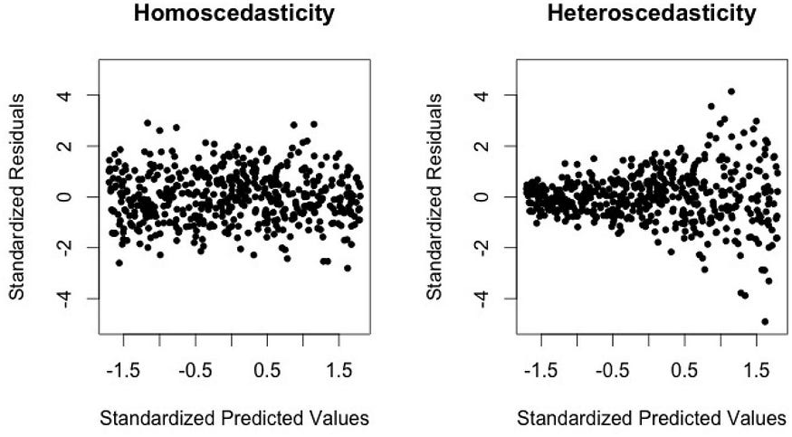
3. Equal Variance Assumption
Another important assumption of the linear regression model is that the error terms have a constant variance (homoscedasticity), Var(ϵi) = σ2. Unfortunately, it is often the case that the variances of the error terms are non-constant. For instance, the variances of the error terms may increase with the value of the response.
One can identify non-constant variances in the errors, or heteroscedasticity
20
Notes:
An example is shown in the left-hand panel of the figure below, in which the magnitude of the residuals tends to increase with the fitted values. When faced with this problem, one possible solution is to transform the response Y using a concave function such as log(Y ) or √X. Such a transformation results in a greater amount of shrinkage of the larger responses, leading to a reduction in heteroscedasticity. The right-hand panel of the figure below displays the residual plot after transforming the response.

Slide 21
Heteroscedasticity
Result of Heteroscedasticity will be an inefficient estimator
Large SE of the estimator
Reasons for heteroscedasticity
The sample size different for each Y
Variance or standard error is a constant percentage of the y-value
How to identify if a model have heteroscedasticity or not?
A scale-location plot between fitted value and standardized residuals can also be checked for heteroscedasticity. It’s also called Spread-Location plot. This plot shows if residuals are spread equally along the ranges of predictors. You can check the assumption of equal variance (homoscedasticity).
21

Slide 22
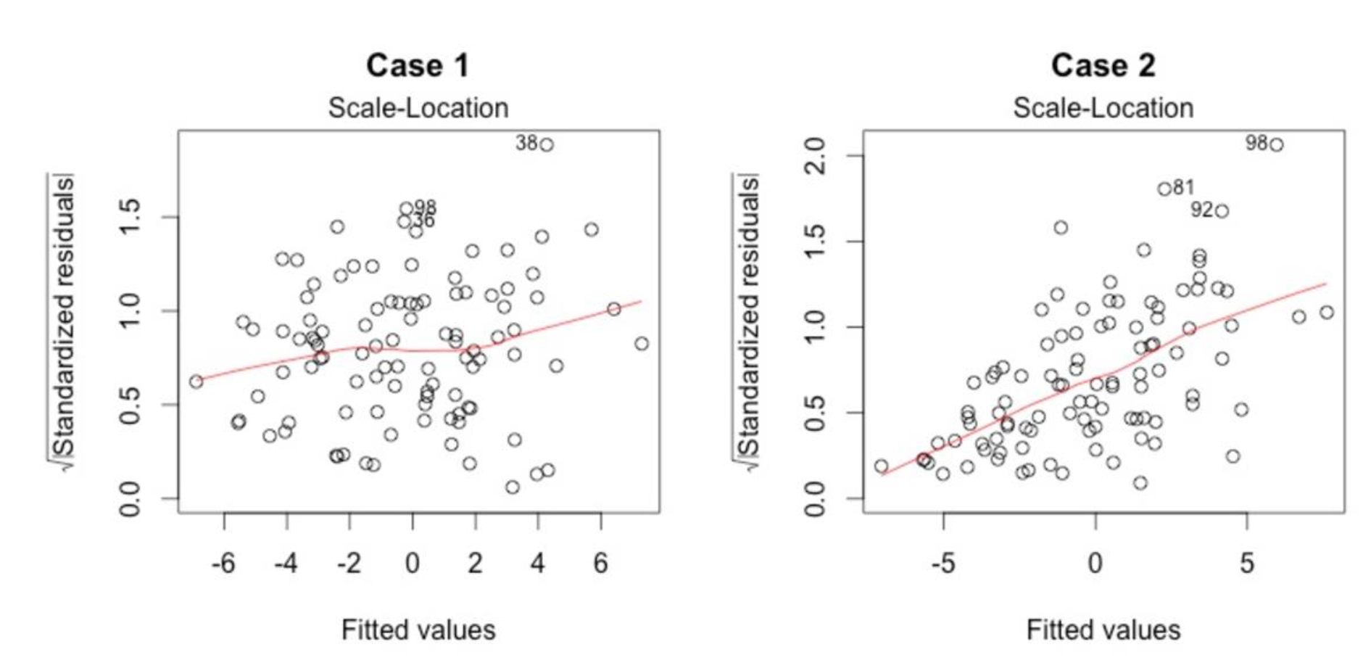
The scale location plot
It’s good if you see a horizontal line with equally (randomly) spread points. From the figure above in Case 1, the residuals appear randomly spread. Whereas, in Case 2, the residuals begin to spread wider along the x-axis as it passes around 5. Because the residuals spread wider and wider, the red smooth line is not horizontal and shows a steep angle in Case 2.
22

Slide 23
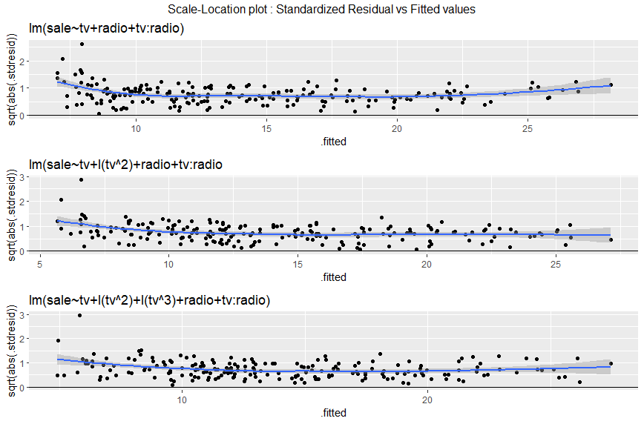
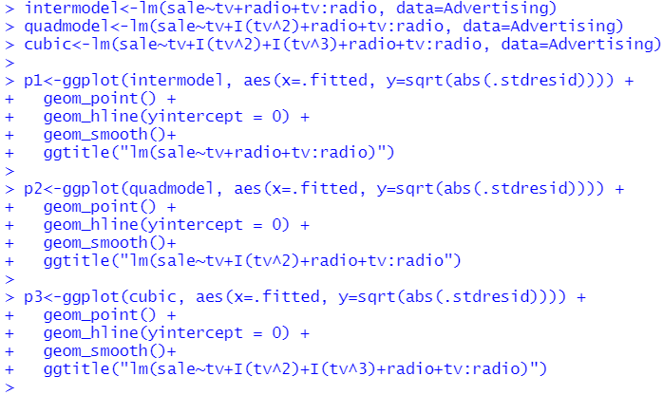
Advertising data Heteroscedasticity
From the Advertising example, the output displays the residual plot and Scale-Location plot that result from the cubic model. In our case, the residuals tend to form a horizontal band-indicates that the plot does not provide evidence to suggest that heteroscedasticity exists.
23

Slide 24

Coffee break

Slide 25
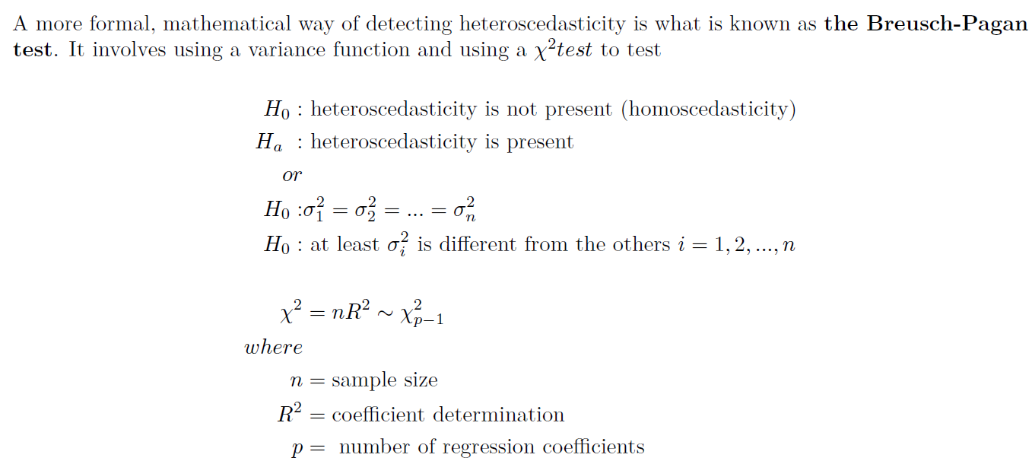
The Breusch-Pagan Test
library(lmtest)
25

Slide 26
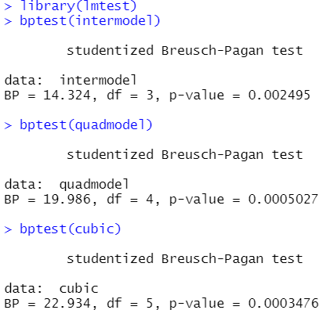
Advertising data
From the Advertising example, the Breusch-Pagan
test p-value are Signiant (p<0.05). We do reject the null hypothesis, which is no presence of Heteroscedasticity.
What can we do now?
26

Slide 27
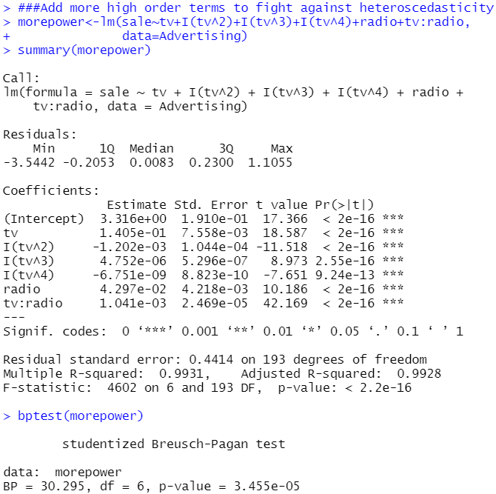
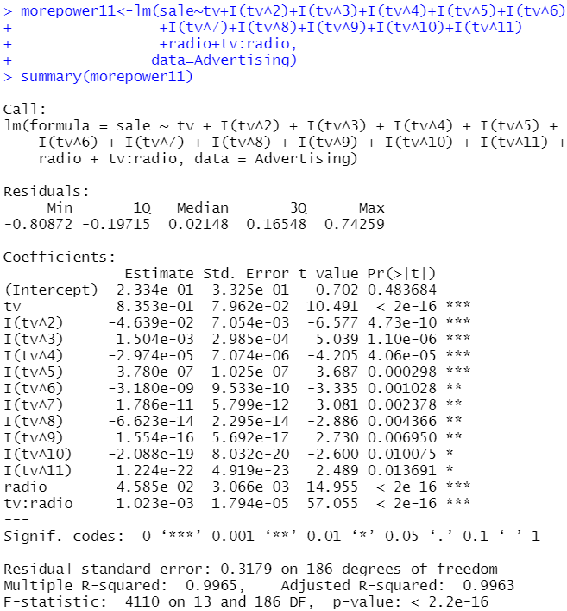
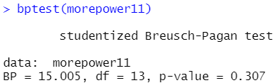
High orders to eliminate Heteroscedasticity

Slide 28
How to deal with heteroscedasticity
If you know how the variance changes with each sample
Weighted Least Square Regression
If the variance has unknown dependence on y_{i}
Other regression methods (GMM, generalized method of moments estimation)
If you know the general trend of variance change with the predictor variable, then you can transform the data
Log-transformation
Box-Cox transformations
These will be studied later…

Slide 29
In class Practice Problem 17
Use the CLERICAL.CSV data.
BEGIN with the best model from PROBLEM 16
Y ~ X2 + I(X2^2) + X4 + X5
Does this model meet the equal-variance assumption?
Examine residual plot and scale-location plot
Conduct the Breusch-Pagan test.
Lecture_6.R
29

Slide 30
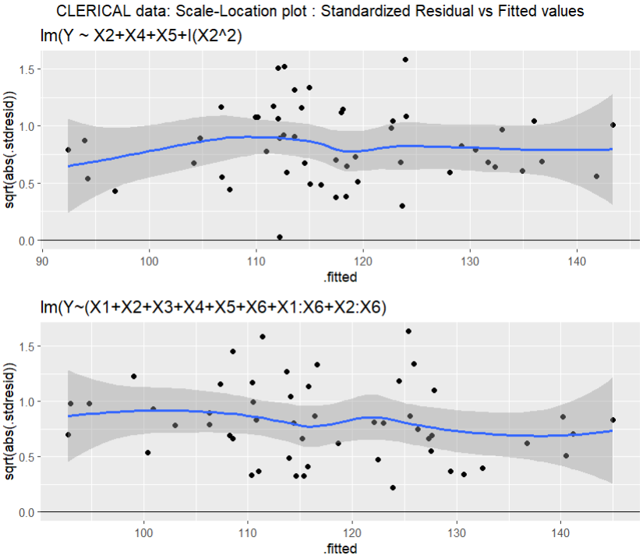
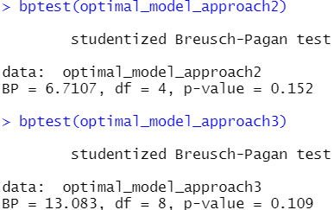
In class Practice Problem 17 Answers
P value 0.152 and 0.109, > 0.05, cannot reject H0.
So we accept H0, which means the error term of model 2 and 3 does not have heteroscedasticity
Lecture_6.R
30

Slide 31
4. Normality Assumption
The multiple linear regression analysis requires that the errors between observed and predicted values (i.e., the residuals of the regression) should be normally distributed.
This assumption may be checked by looking at a histogram, a normal probability plot or a Q-Q-Plot. If the distribution is normal, the points on such a plot (Probability Plot or Q-Q-Plot) should fall close to the diagonal reference line. A bow-shaped pattern of deviations from the diagonal indicates that the residuals have excessive skewness. An S-shaped pattern of deviations indicates that the residuals have excessive kurtosis, i.e., there are either too many or two few large errors in both directions. Sometimes the problem is revealed to be that there are a few data points on one or both ends that deviate significantly from the reference line (“outliers”), in which case they should get close attention.
There are also a variety of statistical tests for normality, including the Kolmogorov-Smirnov test and the Shapiro-Wilk test.

Slide 32
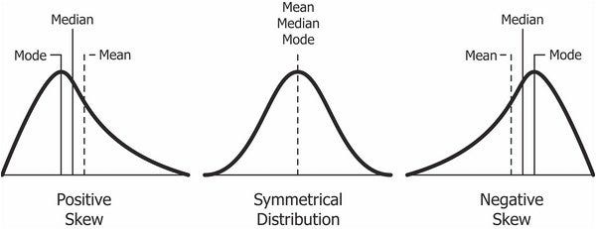
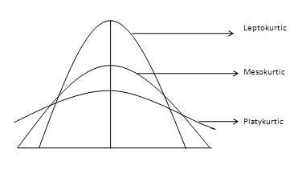
Skewness & Kurtosis
Skewness is a measure of symmetry, or more precisely, the lack of symmetry
Kurtosis is a measure of whether the data are heavy-tailed or light-tailed relative to a normal distribution.
Data sets with medium kurtosis (Mesokurtic, k=3) has kurtosis statistic similar to that of the normal distribution.
Data sets with high kurtosis (Leptokurtic, k<3) tend to have heavy tails, or outliers.
Data sets with low kurtosis ((Platykurtic, k>3) ) tend to have light tails, or lack of outliers.
The histogram is an effective graphical technique for showing both the skewness and kurtosis of data set.
Notes:
Mode: The most frequent number
Positive Skewness means when the tail on the right side of the distribution is longer or fatter. The mean and median will be greater than the mode.
Negative Skewness is when the tail of the left side of the distribution is longer or fatter than the tail on the right side. The mean and median will be less than the mode.

Slide 33
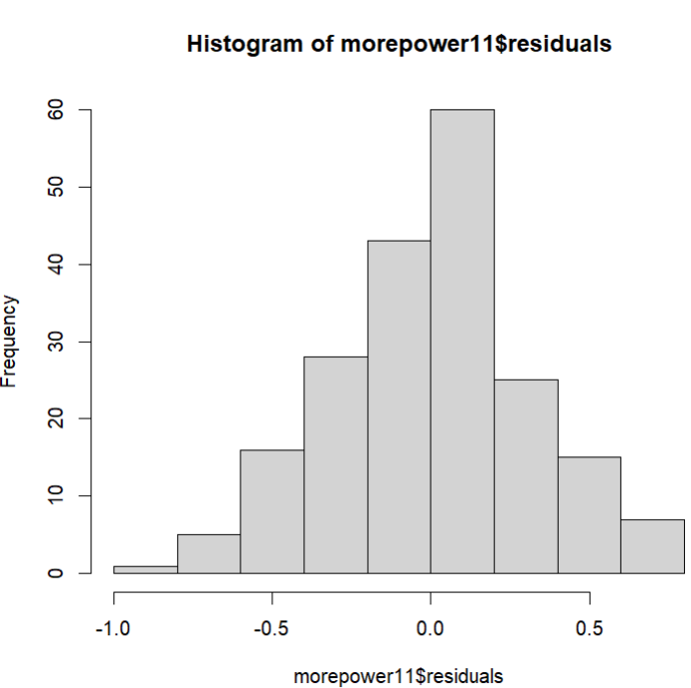
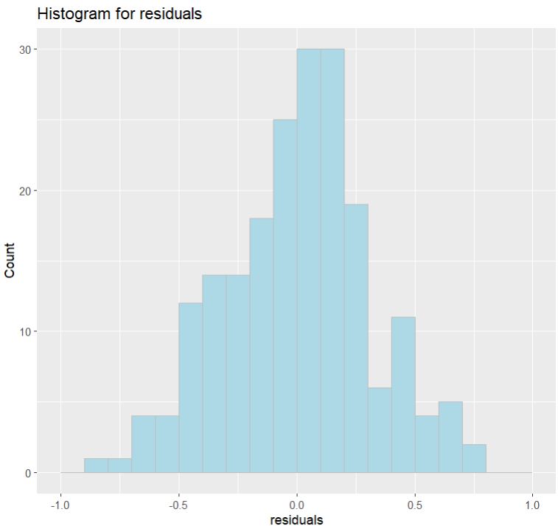
Advertising data Histogram
ggplot(data=Advertising, aes(residuals(morepower11))) +
geom_histogram(breaks = seq(-1,1,by=0.1), col="grey", fill="lightblue") + labs(title="Histogram for residuals") +labs(x="residuals", y="Count")
hist(morepower11$residuals)
33
Notes:
Histogram show the shape of data. I tends to show how the number tend to distribute them throughout dataset. How many data present in the a certain region.

Slide 34
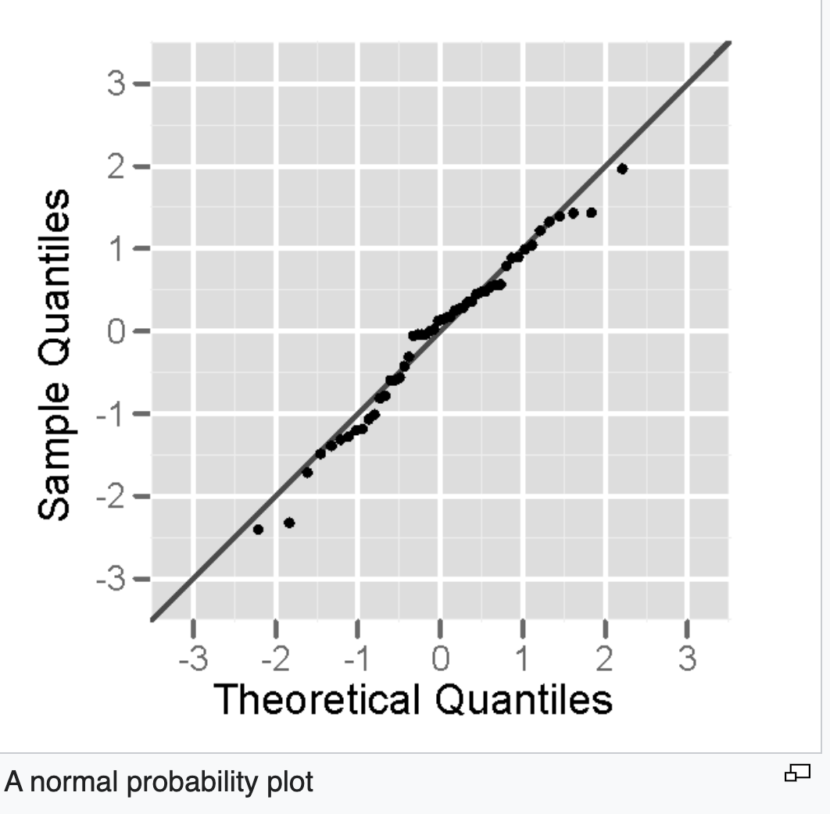
Normal Probability Plot

Slide 35
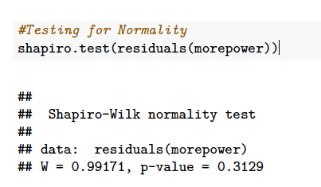
Shapiro Wilk Test

Slide 36
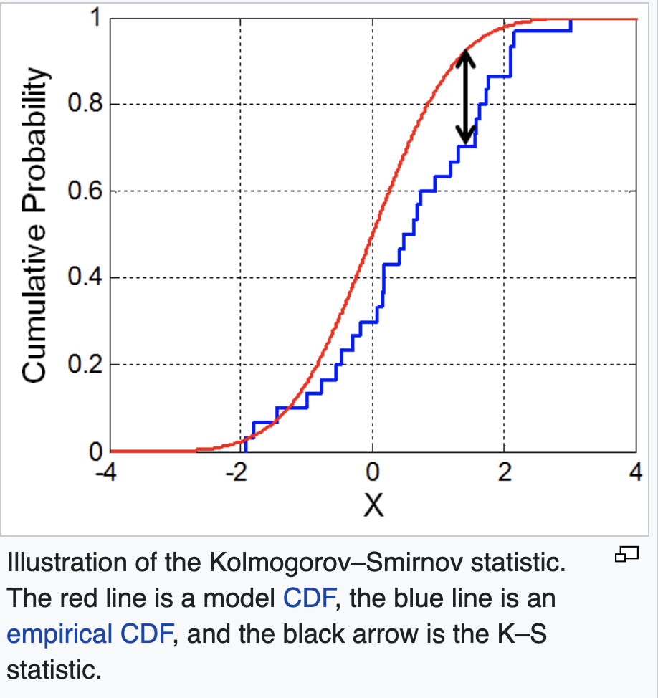
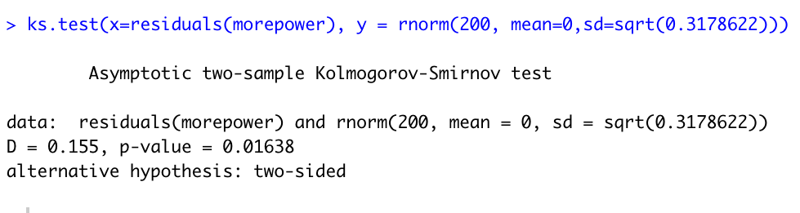
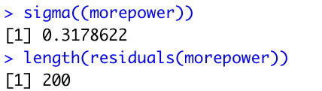
Kolmogorov-Smirnov test

Slide 37
Differences between the two tests
S-W test is a modification of the Kolmogorov-Smirnov (K-S test) and gives more weight to the tails of the distribution than does the K-S test.
The K-S test is distribution free in the sense that the critical values do not depend on the specific distribution being tested.

Slide 38
In class Practice Problem 18
From the clerical staff work hours, use residual plots to conduct a residual analysis of the data. Check Normality Assumption by graphs, Shapiro-Wilk normality test and Kolmogorov-Smirnov test. If you detect a trend, how would you like to transform the predictors in the model?
Lecture_6.R
38

Slide 39
5. Multicollinearity
Often, two or more of the independent variables used in the model for E(Y) provide redundant information.
That is, the independent variables will be correlated with each other. When the independent variables are (linearly) correlated, we say that multicollinearity exists. In practice, it is not uncommon to observe correlations among the independent variables. However, a few problems arise when serious multicollinearity is present in the regression analysis.
What Problems Do Multicollinearity Cause?
The coefficient estimates can swing wildly based on which other independent variables are in the model. The coefficients become very sensitive to small changes in the model.
Multicollinearity reduces the precision of the estimate coefficients, which weakens the statistical power of your regression model. You might not be able to trust the p-values to identify independent variables that are statistically significant.

Slide 40
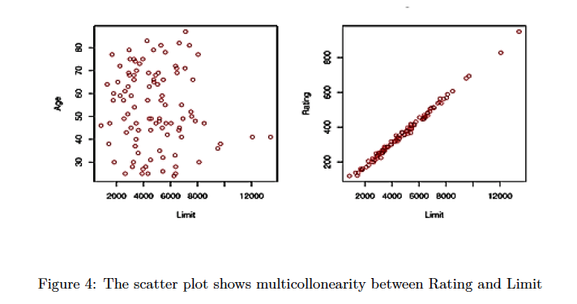
An example:

Slide 41
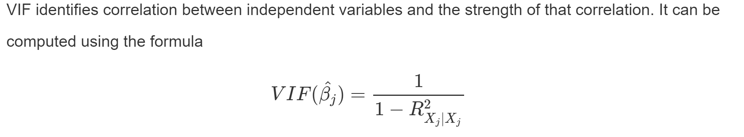
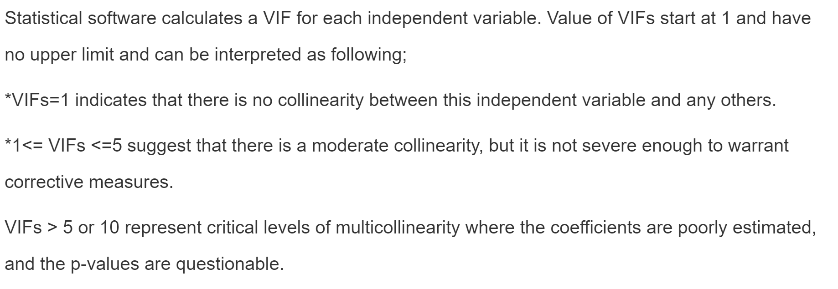
Testing for Multicollinearity with Variance Inflation Factors (VIF)

Slide 42
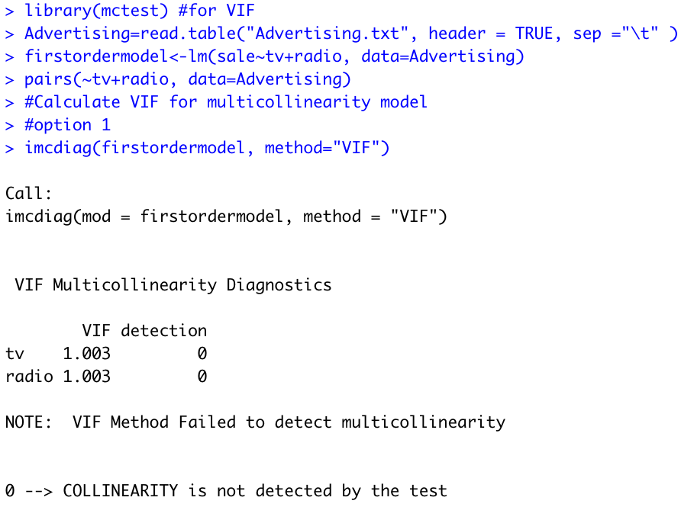
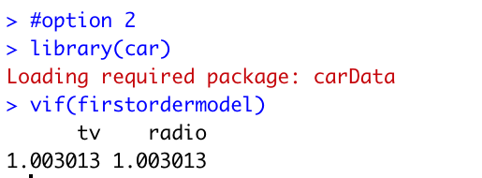
An example:

Slide 43
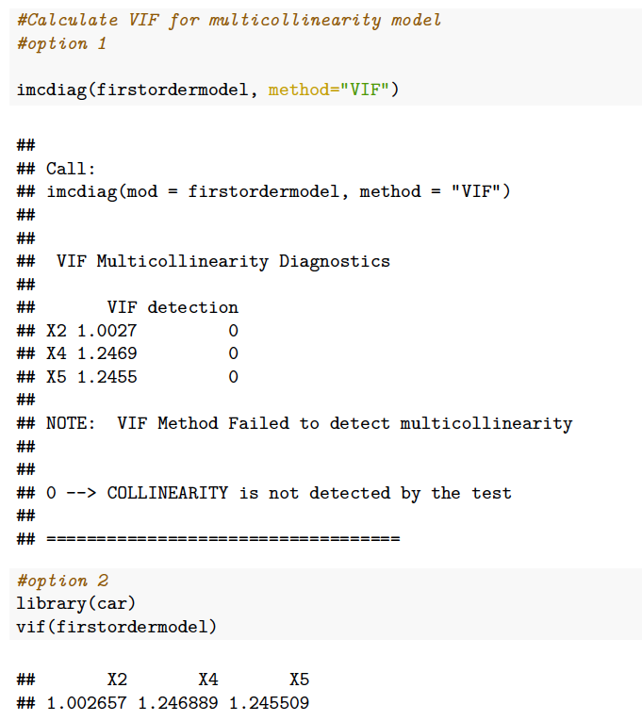
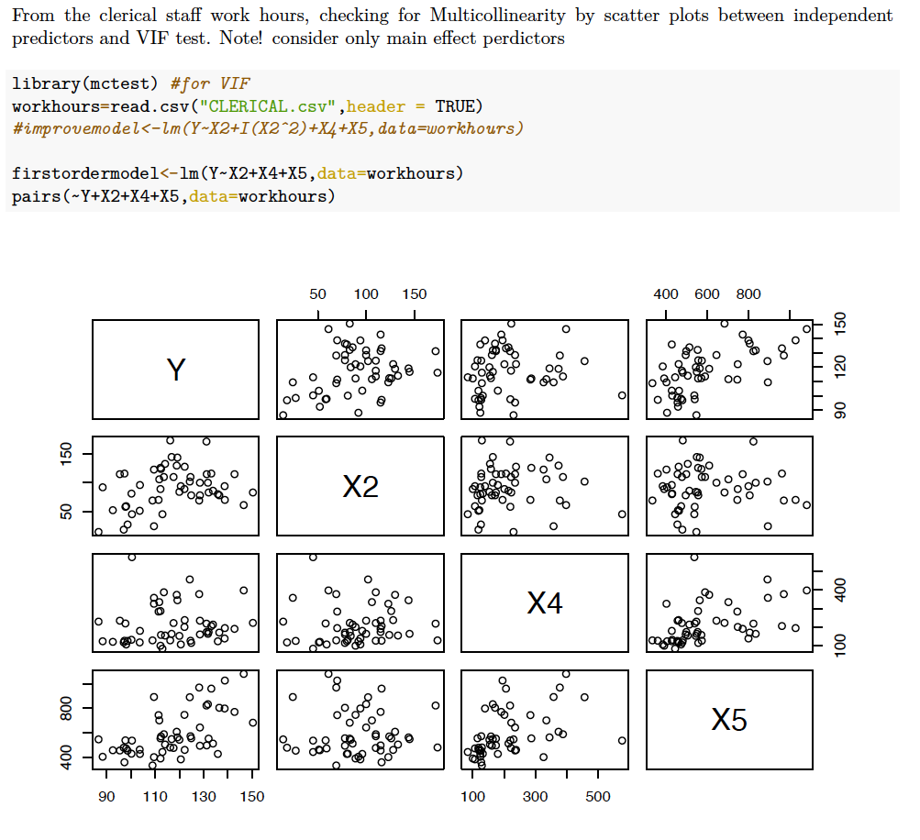
Another example:

Slide 44

In-Class Practice Problem 19
From the credit card example, check for Multicollinearity by scatter plots between independent predictors and VIF test . Note! consider only main effect predictors
pairs():produce a plot matrix, consisting of scatterplots for each variable combination of a data frame.
imcdiag(x=,y=,method=“VIF”) : detects the existence of multicollinearity due to independent variables

Slide 45
Solutions for Multicollinearity
The first solution is to drop one of the problematic variables from the regression model.
The second solution is to combine the collinear variables together into a single predictor.

Slide 46
In-Class Practice Problem 20

Slide 47
6. Outlier (The effect on individual cases)
Outlier: An outlying case is defined as a particular observation (𝑌,𝑋1,𝑋2,...𝑋𝑝) that differs from the majority of the cases in the data set. Potentially caused by a different mechanism (something might wrong)
Possible causes of outliers
Error in recording data (e.g. 28 to 82)
Measurement process/tool problem
Failure of the experimental process
For non-robust statistics, outlier can ruin the analysis. (e.g. mean)

Slide 48
Several key concepts
Outliers: a point that falls far from the other data points.
Leverage: High-leverage points are those observations, if any, made at extreme or outlying values of the independent variables
Influential: If the parameter estimates change dramatically when a point is removed, that point is influential
How influential a point is, is a combination of how much leverage it has and how extreme it is in the y-direction.

Slide 49
Leverage & influence
High leverage, high influence
Low Leverage, some influence

Slide 50
Leverage & influence
High leverage, how influence
What to do with influential point?
Make sure the observation is correctly recorded.
Do the conclusions change?
Can we get more observations near that value of X?

Slide 51
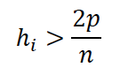
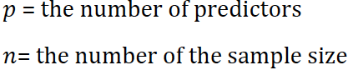
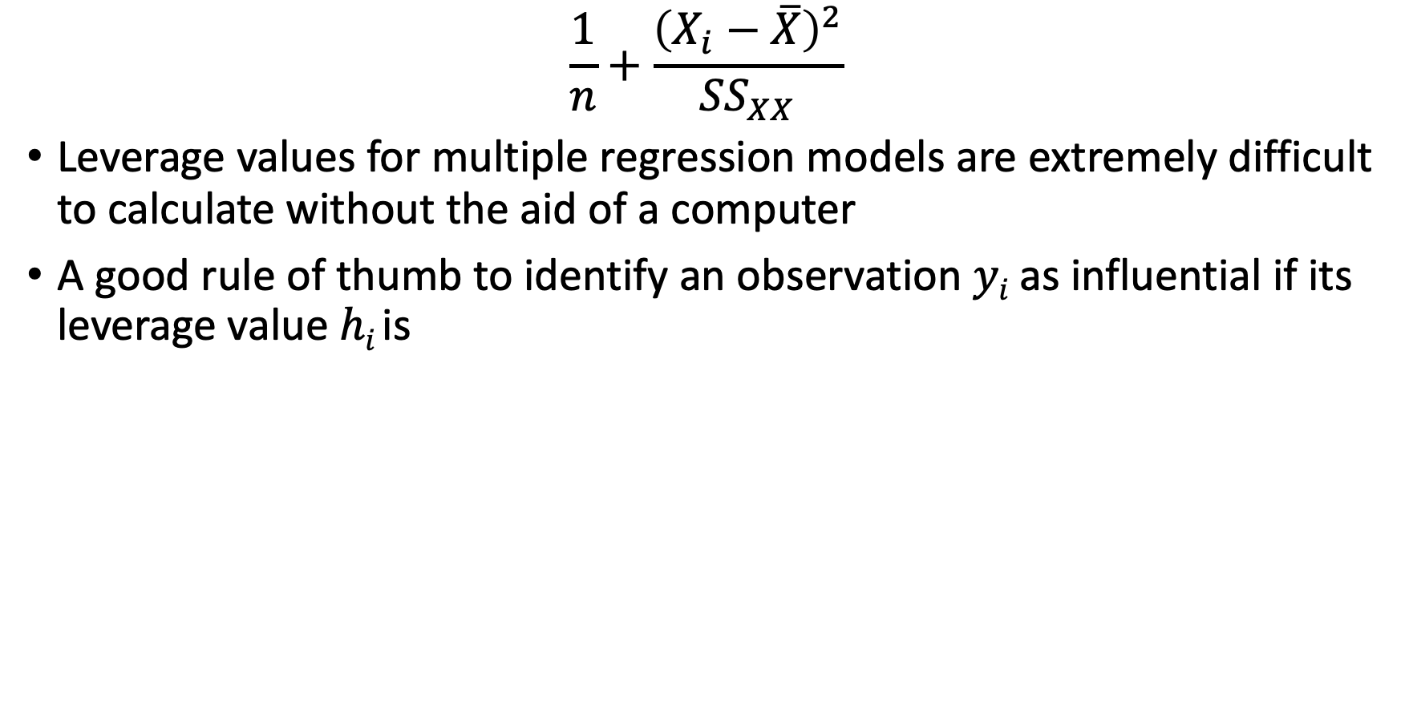
Numeric measures for leverage
$$\frac{1}{n}+\frac{{\left(X_{i}−\overline{X}\right)}^{2}}{{SS}_{XX}}$$
Leverage values for multiple regression models are extremely difficult to calculate without the aid of a computer
A good rule of thumb to identify an observation 𝑦_{𝑖} as influential if its leverage value ℎ_{𝑖} is

Slide 52
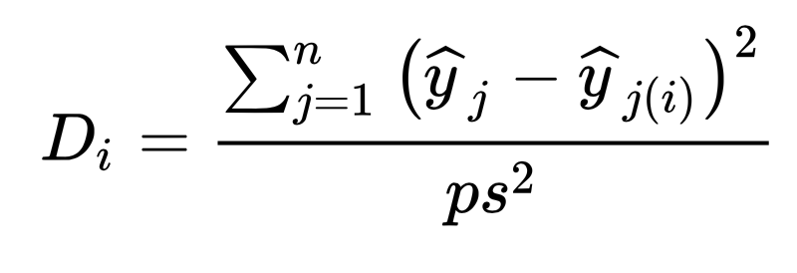
Numeric measure for influence
Cook’s Distance
S is the mean square error of the regression model. p is the number of the parameters in the model

Slide 53
Cook’s Distance
The Cook’s distance 𝐷_{𝑖} measures the effect of deleting a given observation.
A large value of 𝐷_{𝑖} indicates that the observed 𝑌_{𝑖} value has strong influence on the estimated coefficients
A general rule of thumb is that observations with a Cook’s 𝐷 of more than 3 times the mean, 𝜇, is a possible outlier.
An alternative interpretation is to investigate any point over 4/𝑛, where 𝑛 is the number of observations

Slide 54
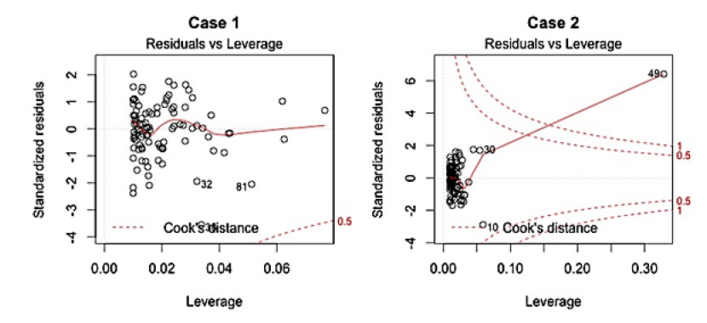
Residuals vs Leverage plot
This plot helps us to find influential cases

Slide 55
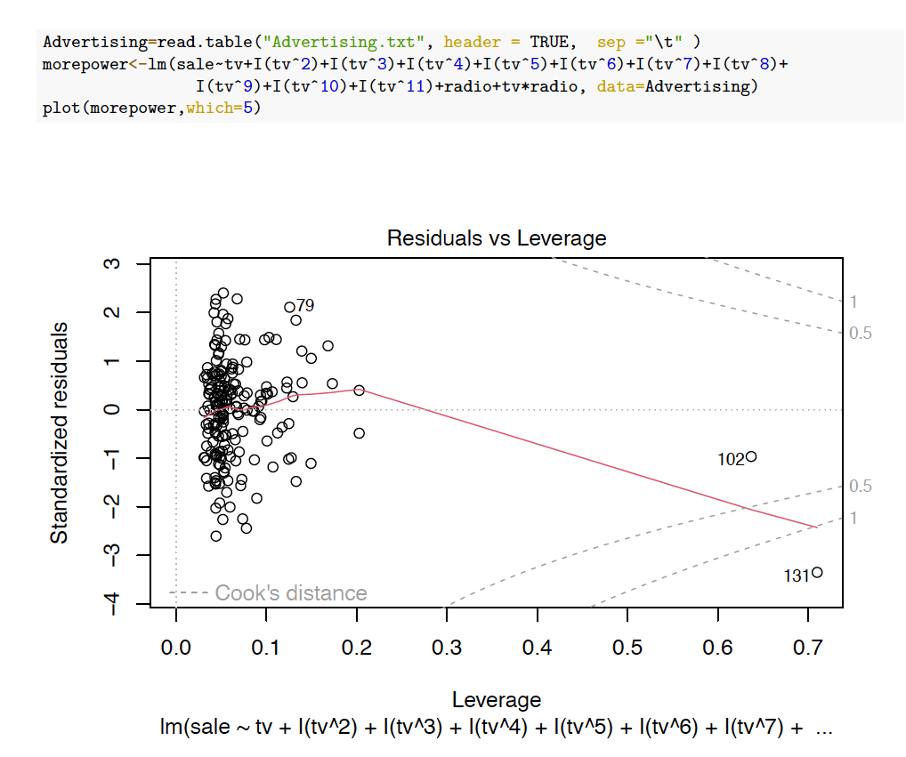
An example using Advertising data

Slide 56
Which()
Which selects which plot to be displayed:
A plot of residuals against fitted values
A normal Q-Q plot
A Scale-Location plot of sqrt(| residuals |) against fitted values
A plot of Cook's distances versus row labels
A plot of residuals against leverages
A plot of Cook's distances against leverage/(1-leverage)

Slide 57
Leverage points

Slide 58
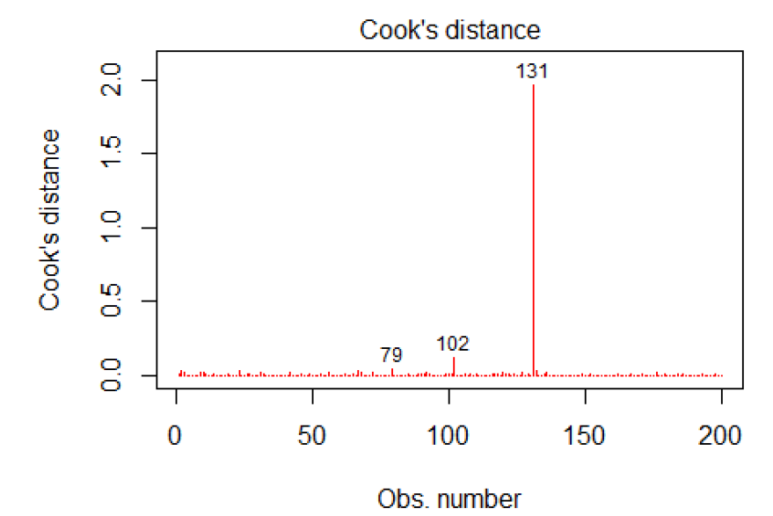
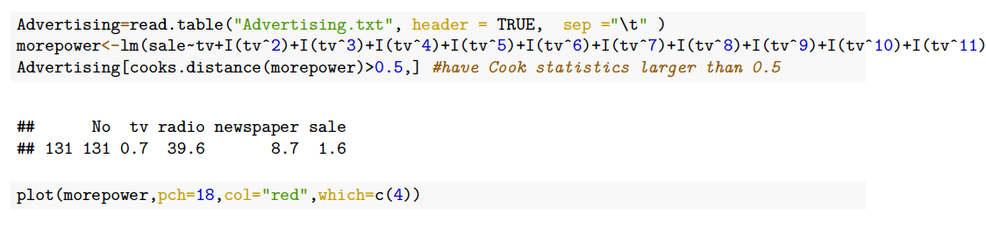
Cook’s distance

Slide 59
In-Class Practice Problem 21 & 22

Slide 60
What to do with outlier
It is always good to identify outliers for the lessons that we can learn.
Investigate these cases separately, to learn the potential reason.
Check what will happen when we exclude the outlier form the model.

Slide 61
Transformation

Slide 62
What is data transformation
Data transformation is the process of changing the format, structure, or value of data
Transformation is used to transform nonnormal data to normal data
Transformation is done by using many functions such as square root, logarithm, power, reciprocal or arcsine, etc.

Slide 63
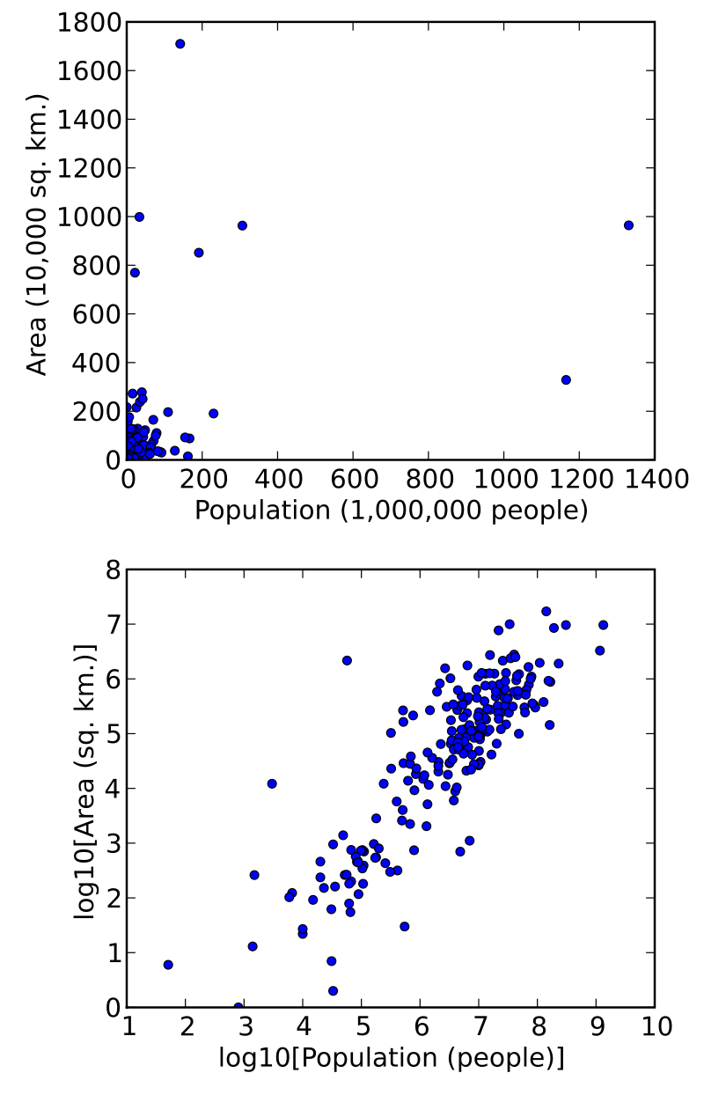
Motivation of transformation
One of the most common assumptions for statistical analyses is that of normality (normality of error terms)
To make interpterion of the data easier
To make appearance of the graphs easier to understand
A scatterplot in which the areas of the sovereign states and dependent territories in the world are plotted on the vertical axis against their populations on the horizontal axis. The upper plot uses raw data. In the lower plot, both the area and population data have been transformed using the logarithm function.
https://en.wikipedia.org/wiki/Data_transformation_%28statistics%29

Slide 64
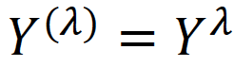
Transformations
Logarithm transformation: If y goes exponentially or as a power of x, transform by taking the log
Square root transformation: If data exhibiting a Poisson distribution (variance =mean), transform by taking the square root.
Box-Cox transformation: a family of power transformation.
where 𝜆 is a parameter to be determined using the data, vairies from -5 to 5

Slide 65
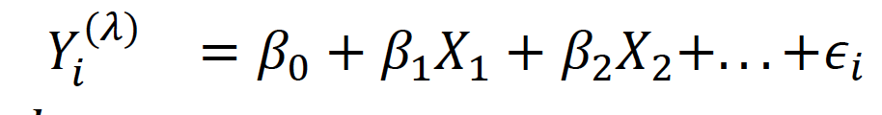


Box-Cox Transformation
Strictly positive response variables
Use MLE to find the best fit $λ$ and betas
Or repeat the OLS for different value of and find the one with minimum SSE.
Round the best fit to the nearest multiple of 0.5, then repeat the regression

Slide 66
The example R code for two datasets

Slide 67
Johnson Transformation
The Johnson Transformation relies on the fact that any function of a normal random variable is also normal. Suppose we have a random variable X that is not normally distributed. We can create a new random variable Y=g(X) where g() is a function that transforms X into a new random variable Y that is normally distributed. If we can find such a function g(), then we can use Y in place of X in any statistical analysis that assumes normality.
There are several cases where the Johnson Transformation can be used, but the most common case is when X is skewed to the left or right. In these cases, the transformation can be used to create normally distributed variables from skew variables.
The advantage of using the Johnson Transformation is that it preserves many of the features of the original skewed distribution. In addition, it’s not subject to positive data as it is available for any data values including negative values. It’s very powerful for determining an appropriate distribution and can by applied to cases which Box-Cox transformation does not fit.

Slide 68
Four types of Johnson Transforms
The linear transformation is the most common and simplest form of the Johnson Transformation. It transforms data by adding or subtracting a constant and then multiplying or dividing by another constant. This transformation creates a new variable that is linearly related to the original variable.
Cumulative probability transformations are used when you want to preserve information about how likely it is for values to fall above or below certain thresholds. These transformations are especially useful for extreme value analysis.
Uniform transformations are used when you want to create variables that are uniformly distributed between 0 and 1. These transformed variables can then be used in Monte Carlo simulations.
Logit transformations are used when you want to create dummy variables from categorical data. Dummy variables are commonly used in regression analysis.
Notes:
The Johnson Transformation is a mathematical transformation used to create new variables from existing variables. It can be used to linearize nonlinear relationships and to create normally distributed variables from non-normal ones.

Slide 69
Important points about OLS regression
There must be linear relationship between independent and dependent variables
Multiple regression suffers from multicollinearity and heteroskedasticity
Linear Regression is very sensitive to Outliers. It can terribly affect the regression line and eventually the forecasted values
Multicollinearity can increase the variance of the coefficient estimates and make the estimates very sensitive to minor changes in the model. The result is that the coefficient estimates are unstable.

Slide 70
The example R code for the dataset

Slide 71
When to use Data Transformation
1. When the data is non-normal
One reason to use data transformation is when the data is non-normal. Non-normal data is data that does not follow a normal distribution, which is a symmetrical bell-shaped curve. Many statistical tests assume that the data is normal, so transforming non-normal data can help to make the results of these tests more accurate.
2. When the data is skewed
Another reason to use data transformation is when the data is skewed. Skewed data is data that is not evenly distributed, with most of the values clustered around one side of the distribution. Skewed data can often be transformed into a more normal distribution, which can be helpful for statistical testing.
3. When the data has outliers
Outliers are extreme values that are significantly different from the rest of the data. When outliers are present, they can often have a significant impact on the results of statistical tests. Therefore, it can be helpful to transform the data in order to reduce the impact of outliers on the results.
4. When you want to compare two or more groups of data
Another reason to use transformation is when you want to compare two or more groups of data. Some statistical tests require that the groups being compared have equal variance, which is a measure of how spread out the values are within a group. Transforming the data can often help to equalise the variance between groups, which can make comparisons more accurate.
5. When you want to stabilise variance over time
If you have data that was collected over time, you may want to use transformation in order to stabilise variance over time. Variance stabilisation helps to ensure that any changes in the mean are not due simply to changes in variance over time, which can make interpretation of results more difficult

Slide 72

Take away messages
Statistics:
Code:

Slide 73
Assumptions
 | Assumptions | Descriptions | Measurements | Potential actions
1 | Linearity Assumption | Relationships between all predictors and the response are linear | 1. residuals – fitted y values plot | Add high order terms or transform data
2 | Independence Assumption | Independence of observations | 1. Residuals vs predictors | Use other models than MLR
3 | Equal Variance Assumption | Error term has equal variance given any values of independent variables | Scale-Location plot. [square root of standardized residuals – fitted y values plot] Breusch-Pagan test (H0: no hetero) | Add high order terms or transform data
4 | Normality Assumption | Error term is normally distributed | Histogram Normal probability plot Q-Q plot Kolmogorov-Smirnov test Shapiro-Wilk test
5 | Multicollinearity
6 | Outlier

